Slide 1


第2組
報告主題： Fragmented NFT trading platform
組員分工
Z21124002 名字：上台報告
Z21124002 名字：製作投影片
Z21124009 名字：項目分析
Z21124012 名字：項目研究兼PM

Slide 2
Table of contents
Liquidity problems in NFTs market
OpenSea -- How much does it cost to buy and sell an NFT
NFTX – A fragmented NFT trading platform
Disadvantages of NFTX
Introduce our own fragmented NFT trading platform
The advantages of our platform

Slide 3
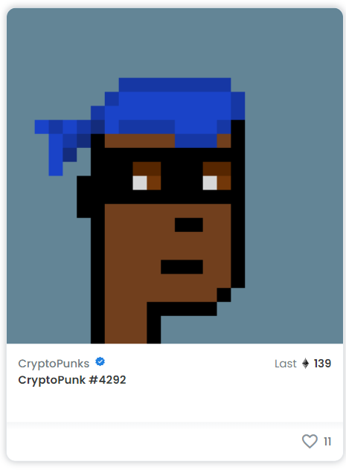
Liquidity problems in NFTs market
High Unit Price For example, investor now have to spend 140 ether to buy a single Punk, which is almost 55K USD.
High Gas Fee At present, many well-known NFT projects are still issued on Ethereum. Everyone knows that the fees of Ethereum are very expensive
High Trading Fee In addition to gas fee, trading NFTs usually has to pay royalties (maybe around 5%). In the long run, this is a lot of money

Slide 4
OpenSea – How much does it cost to trade a nft
Everyone knows that OpenSea is the largest NFT market on Ethereum, but guess how much it will cost to complete an NFT transaction on it?
EVERY STEP NEEDS GAS FEE !!!
Buying a NFT 1. approve selecting token (about 46K gas) 2. automic match (about 200K gas)
Selling a NFT 1. initializing wallet (first time selling) (about 400K gas) 2. approving item for sale (about 50K gas) 3. When the NFT is sold and the payment is received, opensea will automatically charge transaction fees and royalties, which are generally 7.5% of the total transaction amount ESTIMATE TOTAL TRADING FEE: 696K gas * 80 Gwei/gas = 0.055 ETH + 7.5% Transaction amount

Slide 5
NFTX – A fragmented NFT trading platform
30 days unique users: 9
30 days volume: 683k USD
(data powered by DappRadar --https://dappradar.com/ethereum/collectibles/nftx)
Category: fragmented NFTs exchange
Main functionalities:
(1) Allow users to add NFTs to smart contract and mint ERC-20 tokens
(2) Users can trade these ERC20 tokens to obtain the ownership of random NFTs in the contract
URL: https://nftx.io/
docs: https://docs.nftx.io/

Slide 6
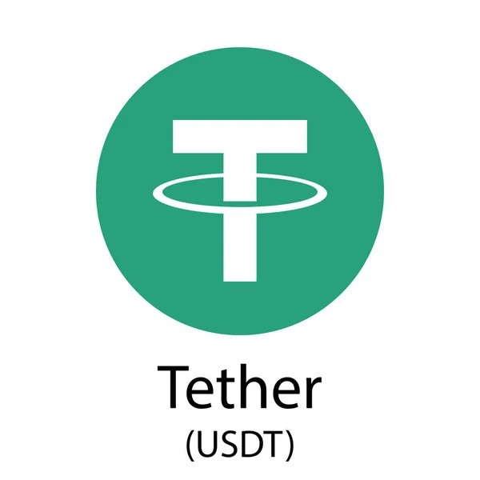
NFTX – what is nft fragmented token
It is very similar to the mode of USD stable coin.
However, the difference is that we use smart contracts to ensure that every NFT fragmented token is 100% backed by a corresponding NFT asset.
Unlike the fiat currency assets behind USDT. No one knows if it is backed by real U.S. dollars

Slide 7
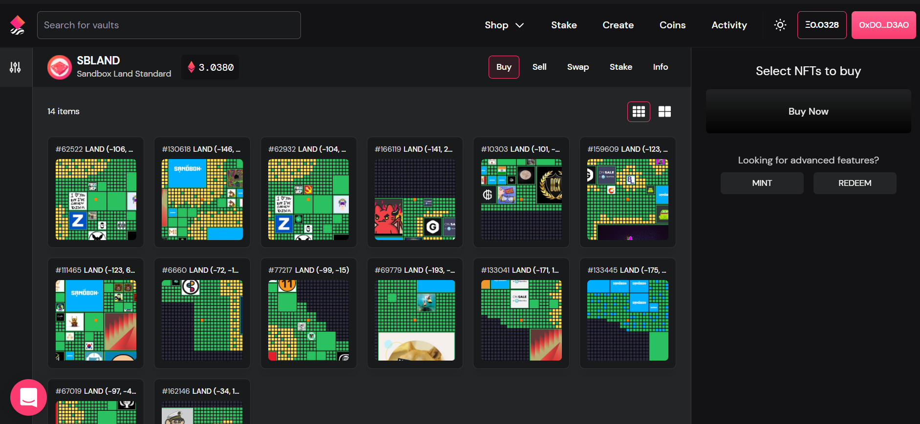
NFTX -- UI
https://nftx.io/

Slide 8
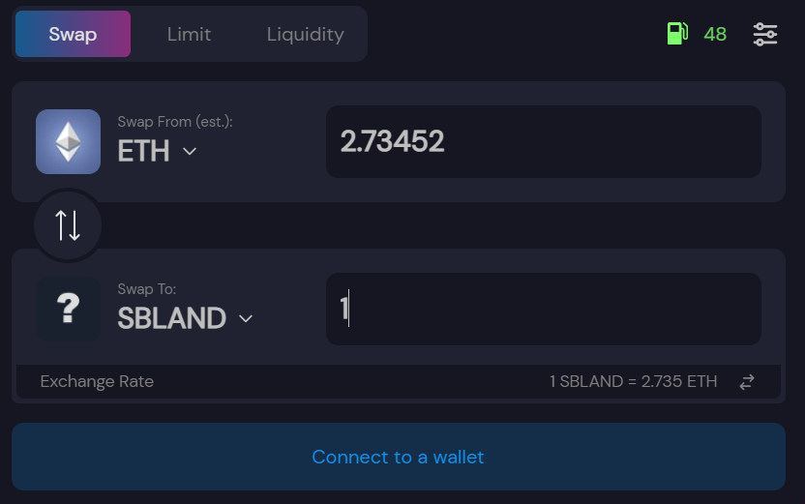
NFTX – token in sushiswap
https://nftx.io/

Slide 9
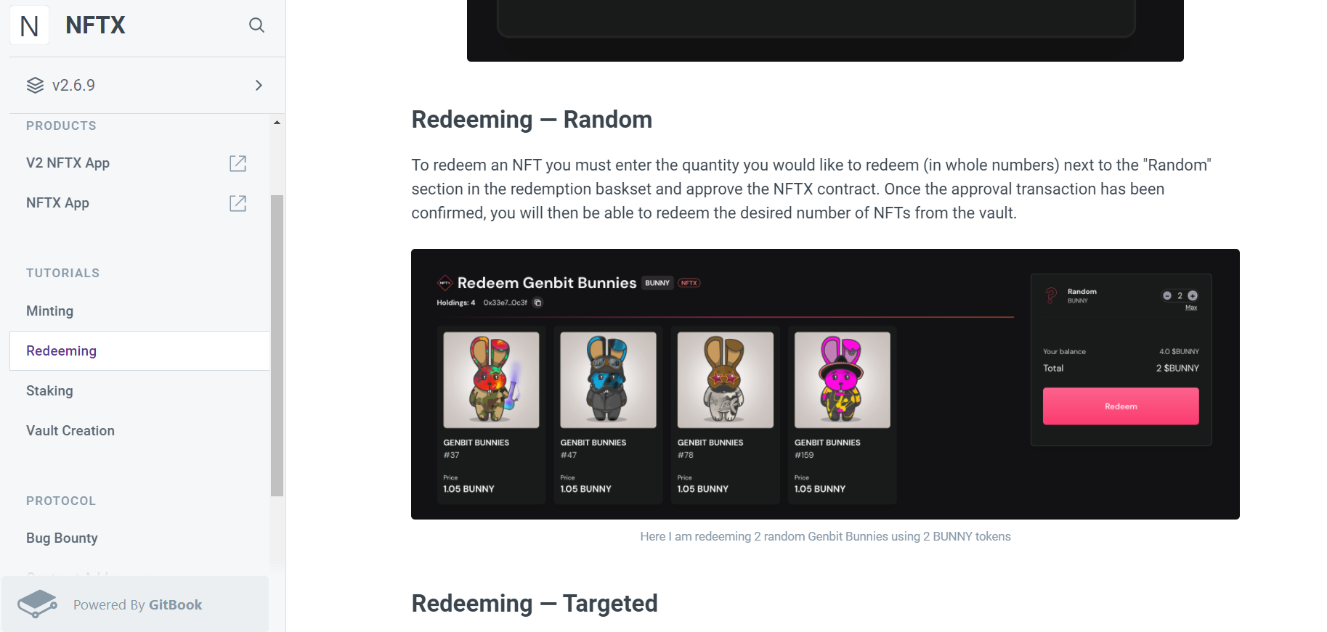
NFTX -- docs
https://nftx.io/

Slide 10
DisadvAntages of nftx
1. Sing the Same Old Song --- High Gas Fee Because the platform is completely issued on Ethereum, the gas fee for obtaining ERC-20 tokens is too high, which is not friendly to petty bourgeoisie. Our target customer group is the petty bourgeoisie who can't afford an entire NFT. If they want to trade tokens and have to pay the sky-high gas fee of Ethereum, wouldn't it be weird?
2. HODL Fragmented NFTs token with no Interest Income In crypto market, any user who has held tokens for a period of time should earn interest. However , those who hold the NFT fragmented token issued by NFTX don’t earn any interest.

Slide 11
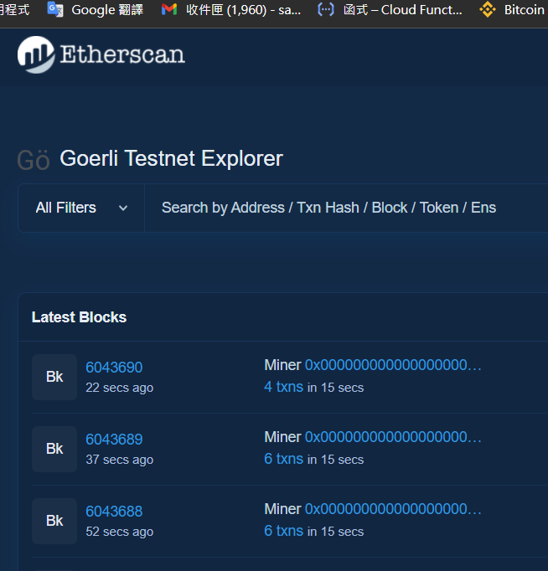
DisadvAntages of nftx
3. Testnet is not Supported This project does not seem to support the testnet. If users cannot practice the interface through the testnet, they may be afraid to transfer their assets
4. Without a Mobile App It is not convenient to operate without a mobile app. Any project in this era should support a mobile app

Slide 12
Introduce our own fragmented nfts trading platform
In our platform , users can add NFTs to smart contract and mint the corresponding ERC-20 tokens just like NFTX.
For example , users will offer The Sandbox's Land to our smart contract in exchange for S’Land token we issued.
Also, redemptions allow users to take ownership of an underlying NFT from within a token.

Slide 13
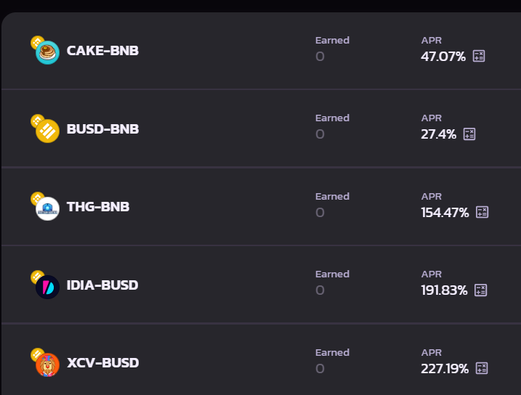
Introduce our own fragmented nfts trading platform
When users get fragmented NFT tokens we issued, they have the following options 1. Simply HODL the tokens to be up 2. Realize their tokens to MATIC or USDC 3. Deposit the tokens and some valuable coins (such as MATIC, USDC) into the liquidity pool to earn transaction fee income

Slide 14
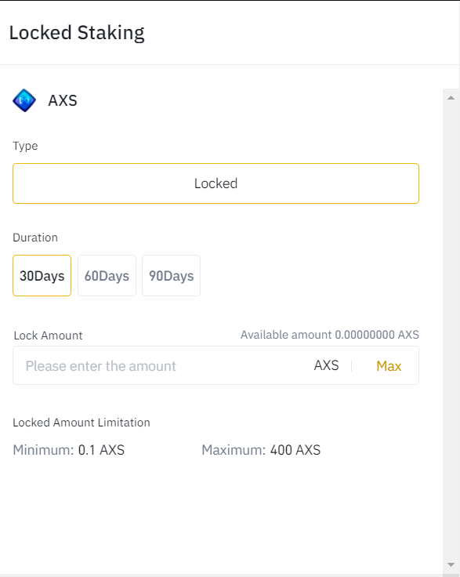
Introduce our own fragmented nfts trading platform
4. Put the token in the staking pool for a period of time. JUST LIKE STAKING TOKEN IN BINANCE EARN At this time, we will lease the underlying NFT assets of the token to those in need and help the lessor earn rental income. The leased NFT assets will be protected in the form of smart contracts to prevent tenants from realizing or transferring NFTs
We will never move the NFT assets at the bottom of user’s tokens unless users stake their tokens !!! (unlike USDT)

Slide 15
The advantages of our platform
1. No Gas Fee Although mint and redeem NFT on Ethereum requires high gas fee. However , we will be able to save almost all gas fee of trading fragmented NFT tokens through the Polygon side chain.
2. No royalties and high liquidity Through NFT tokenization, it is easier for traders to find opponents when trading NFT assets and save high-value NFT transaction royalties
3. Be a landlord by staking If users use the function of staking tokens, users can also obtain idle asset income by renting out their NFTs. Even if they only have fragmented NFTs, they also can be a small landlord.

Slide 16
Q&A
Notes:
The four key points we will cover later are:

